Slide 1





Olist Store Analysis
Group 5
Selvaji M Priyanka
Kodi Vamshisai Deekshith Murali U Arakala Tulasi Pulluri Nithin Rao Aditya Anil Chavan

Slide 2
Kpi’s
I N D E X
1. Weekday Vs Weekend (order_purchase_timestamp) Payment Statistics
2. Total no.of Orders with review score 5 and payment type as credit card.
3. Average number of days taken for order_delivered_customer_date for
pet_shop
4. Average price and payment values from customers of sao paulo city
5. Relationship between shipping days Vs review scores.
Dashboards
1. Challenges faced in the project.
2. MySQL queries
3. Excel Dashboard
4. Power Bi Dashboard
5. Tableau Dashboard

Slide 3
INTRODUCTION
Olist store analysis project aims at understanding the performance of the store on E-commerce platform to drive business growth and improve overall efficiency.
This Olist store analysis project covers different kpi’s which can help in were the store have to make changes, improve or maintain the consistence, etc.
The project will explore various aspects, such as delivery time, customer satisfaction, payment statistics, popular products, value customers, etc. which in turn help the store to increase the profits of the business.

Slide 4
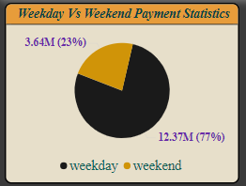
Kpi 1: Weekday Vs Weekend Payment Statistics
Kpi 1 gives Olist store in detail understanding of the buying behavior of customers on weekday and weekend, based on payment statistics.
It is clear that the store has more orders or business on weekdays with
12.37 M i.e. around 77% of business
happens on weekdays. On weekend the
store made 3.64 M of business i.e. 23%
on weekend.
It clearly shows that store should think
about increasing their business on
weekend’s. they can give weekend
special offers, discounts on purchases
on weekend. So that store can increase
sales on weekend.

Slide 5
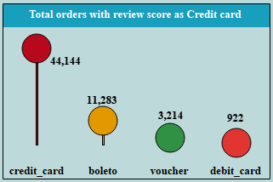
Kpi 2:Total no.of Orders with review score 5 and payment type as credit card.
Through Kpi 2 we can observe that with the review score of 5 and payment type as credit card the store got around 44,000 orders.
Compared to other payment types, more orders has been placed via credit card payment i.e. more
than 70% of the sales were
paid by credit card than boleto,
vouchers and debit card.
So, if we want to increase the
sale we can give certain amount
of discounts or no cost EMI’s
on the card payments

Slide 6
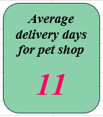
Kpi 3: Average number of days taken for order delivered customer date for pet shop
Through Kpi 3 Olist store can analyze days taken to deliver orders to its customers.
On an average the olist store have taken 11 days to deliver the order to the pet shop.
This information can help the Olist store to identify
the areas to improve and also decrease the days taken
to deliver the orders for the customers.
As a result the store can maintain customer satisfaction
and also maintain stores goodwill in the market.

Slide 7
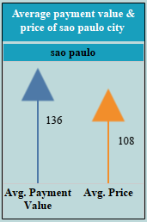
Kpi 4: Average price and payment values from customers of sao paulo city
Through Kpi 4 we can see customers from sao paulo city
have high Average price i.e. 108 and also have high
Average payment value i.e. 136 for their purchases when
compared to customers from other locations.
As these details helps Olist store to understand the
spending patterns of customers in the sao paulo city. So
that the store can identify high value customers and target
them to increase the market value of the store.
By understanding preferences and behavior of customers in
the city, the store can think about pricing strategies,
customer satisfaction with the services and stay ahead
in the market.

Slide 8
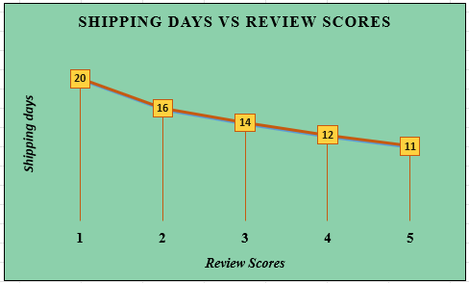
Kpi 5: Relationship between shipping days Vs review scores
Kpi 5 will give us information about how many days the Olist store have taken to deliver the order to the customers and level of customer satisfaction based on time taken for delivering the order.
Customer satisfaction can be analyzed based on review score for they services. If review score is 5 it means customers have high level of satisfaction. If review score is 1 it means that customers are
not satisfied
with the services of the store.
This information helps the Olist
store to improve in customer
service in all the areas like
delivery days taken, quality of
product, shopping experience,
etc.

Slide 9
Dashboards

Slide 10
Challenges faced in the project
Challenges we faced while doing the Olist store project was cleaning the data. First, we cleaned the data, removed the duplicate, null and blank values and merged the tables. But for 2nd and 4th Kpi’s we were not getting the exact values.
Next, for power bi and tableau we merged the csv files using data modelling without cleaning the data. Now, we were able to get nearest value for kpi 2 but still not able to get exact payment value in kpi 4.
Making dashboards and alignments in it were bit challenging because the charts, values in it, and x and y axis labels should be visible without anything missing out.

Slide 11
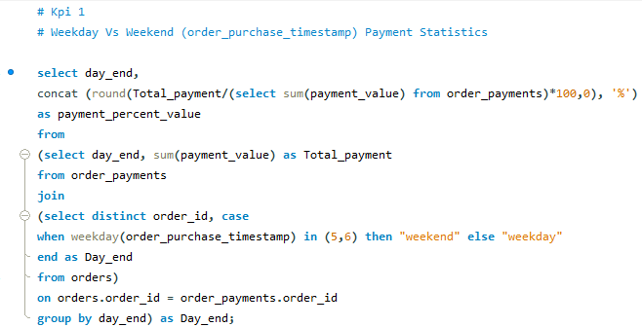
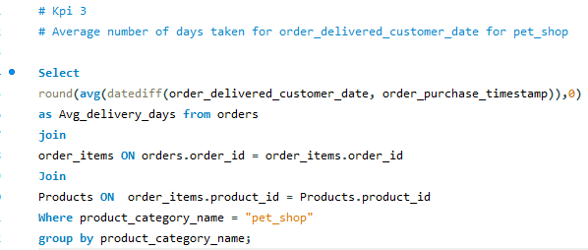
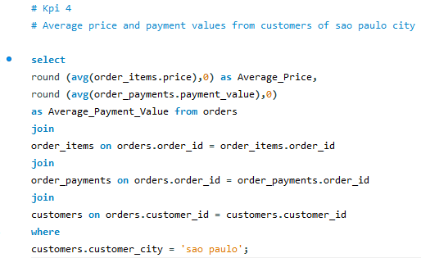
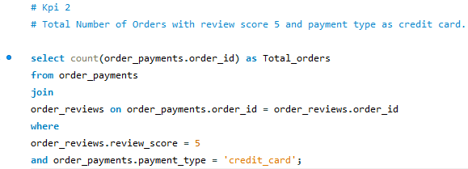
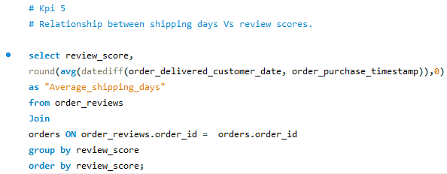
M Y S Q L Q U E R I E S

Slide 12
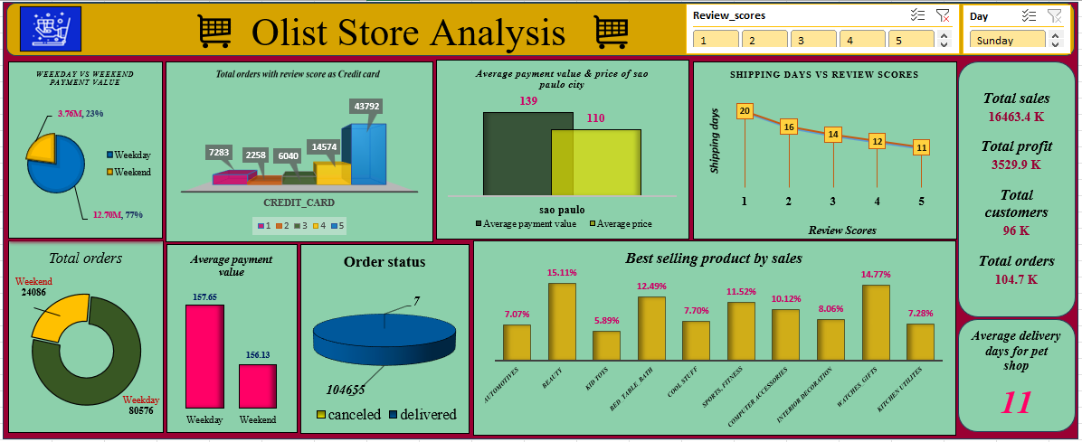
E X C E L D A S H B O A R D

Slide 13
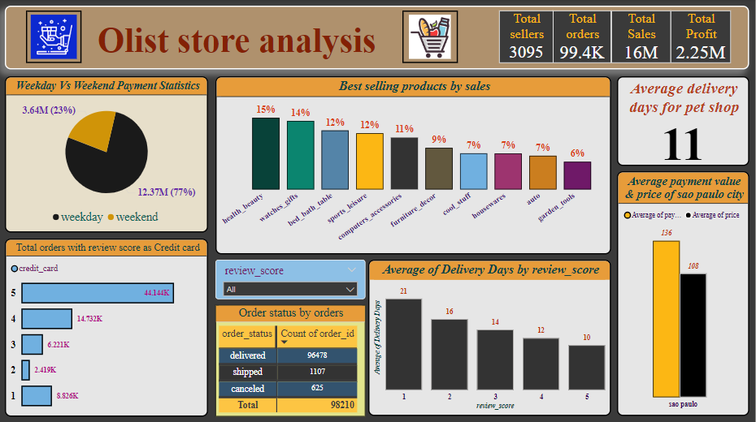
P O W E R B I D A S H B O A R D

Slide 14
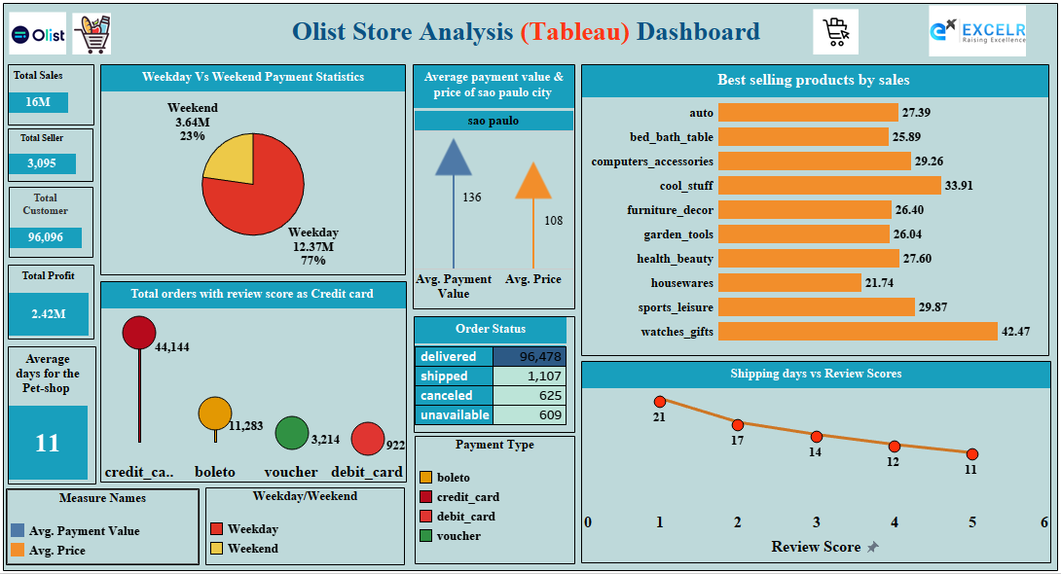
T A B L E A U D A S H B O A R D

Slide 15
Thank you

